Slide 1

DEEPFAKE DETECTION
(DEMO MODEL APPROCH )

Slide 2

We are making a demo project to understand deepfake and further improve the accuracy of it, with the dataset :
Faceforensics++
Celebrity DF dataset
Challenging deepfake dataset

Slide 3
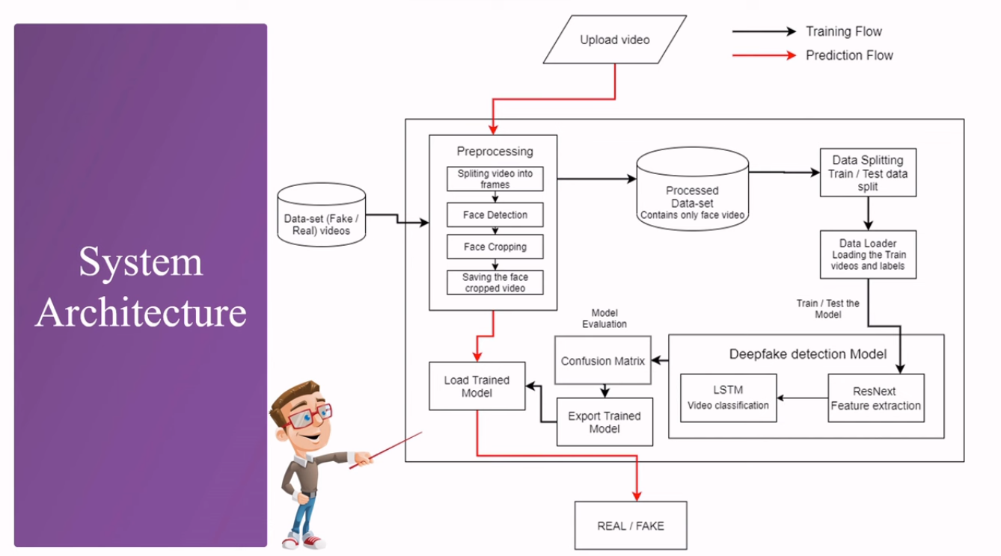

Slide 4
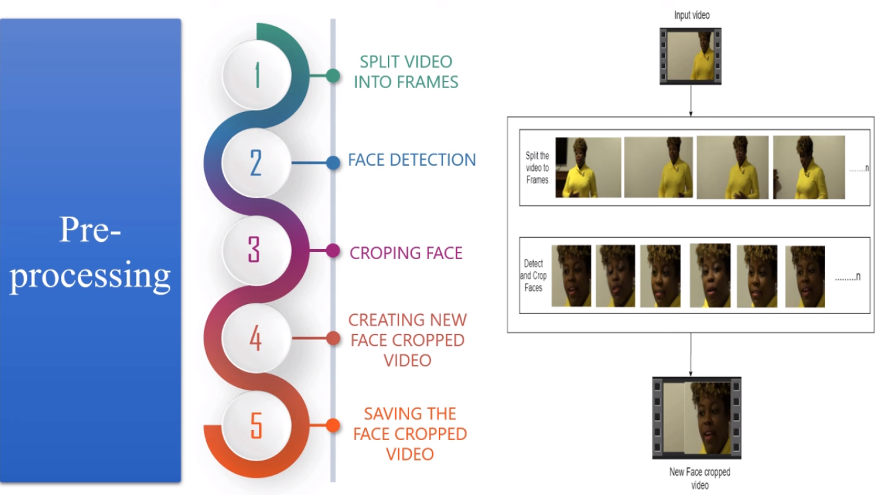

Slide 5
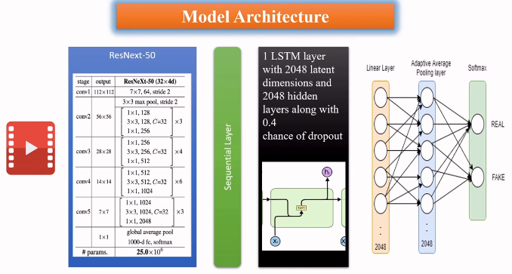

Slide 6
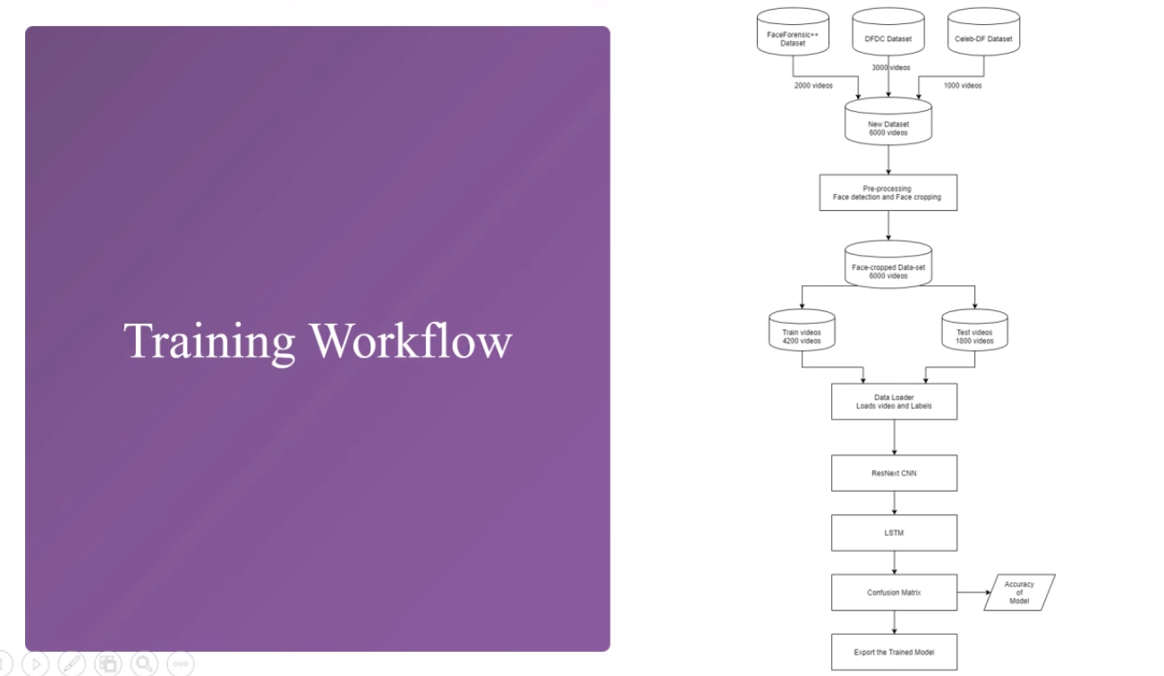

Slide 7
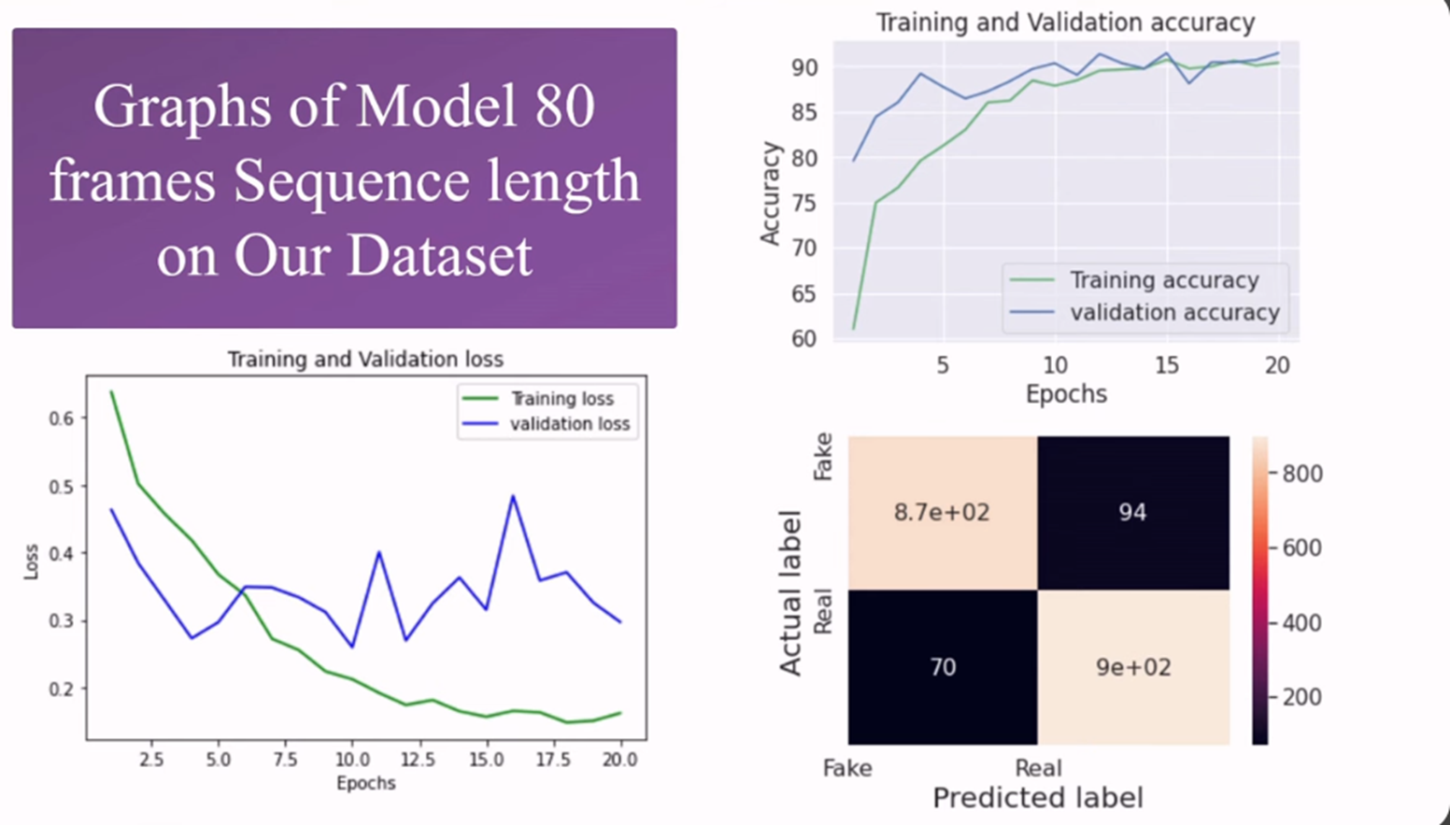

Slide 8
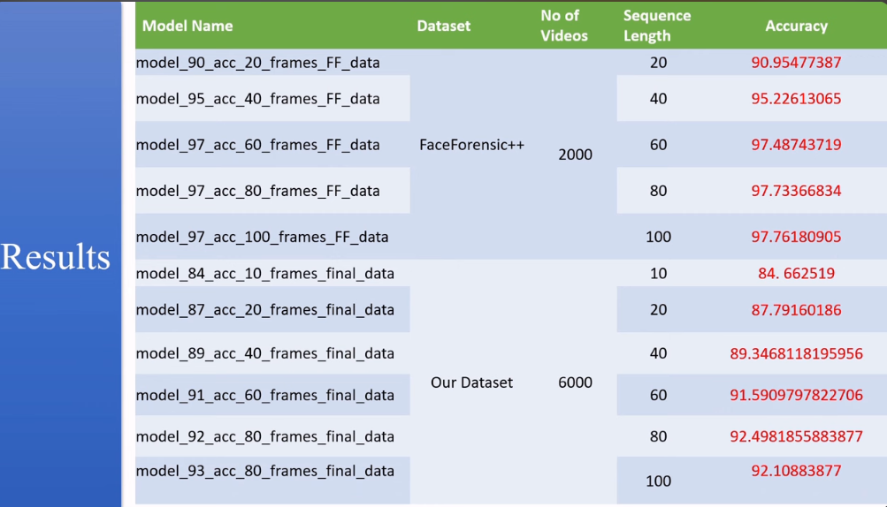

Slide 9
